Slide 1
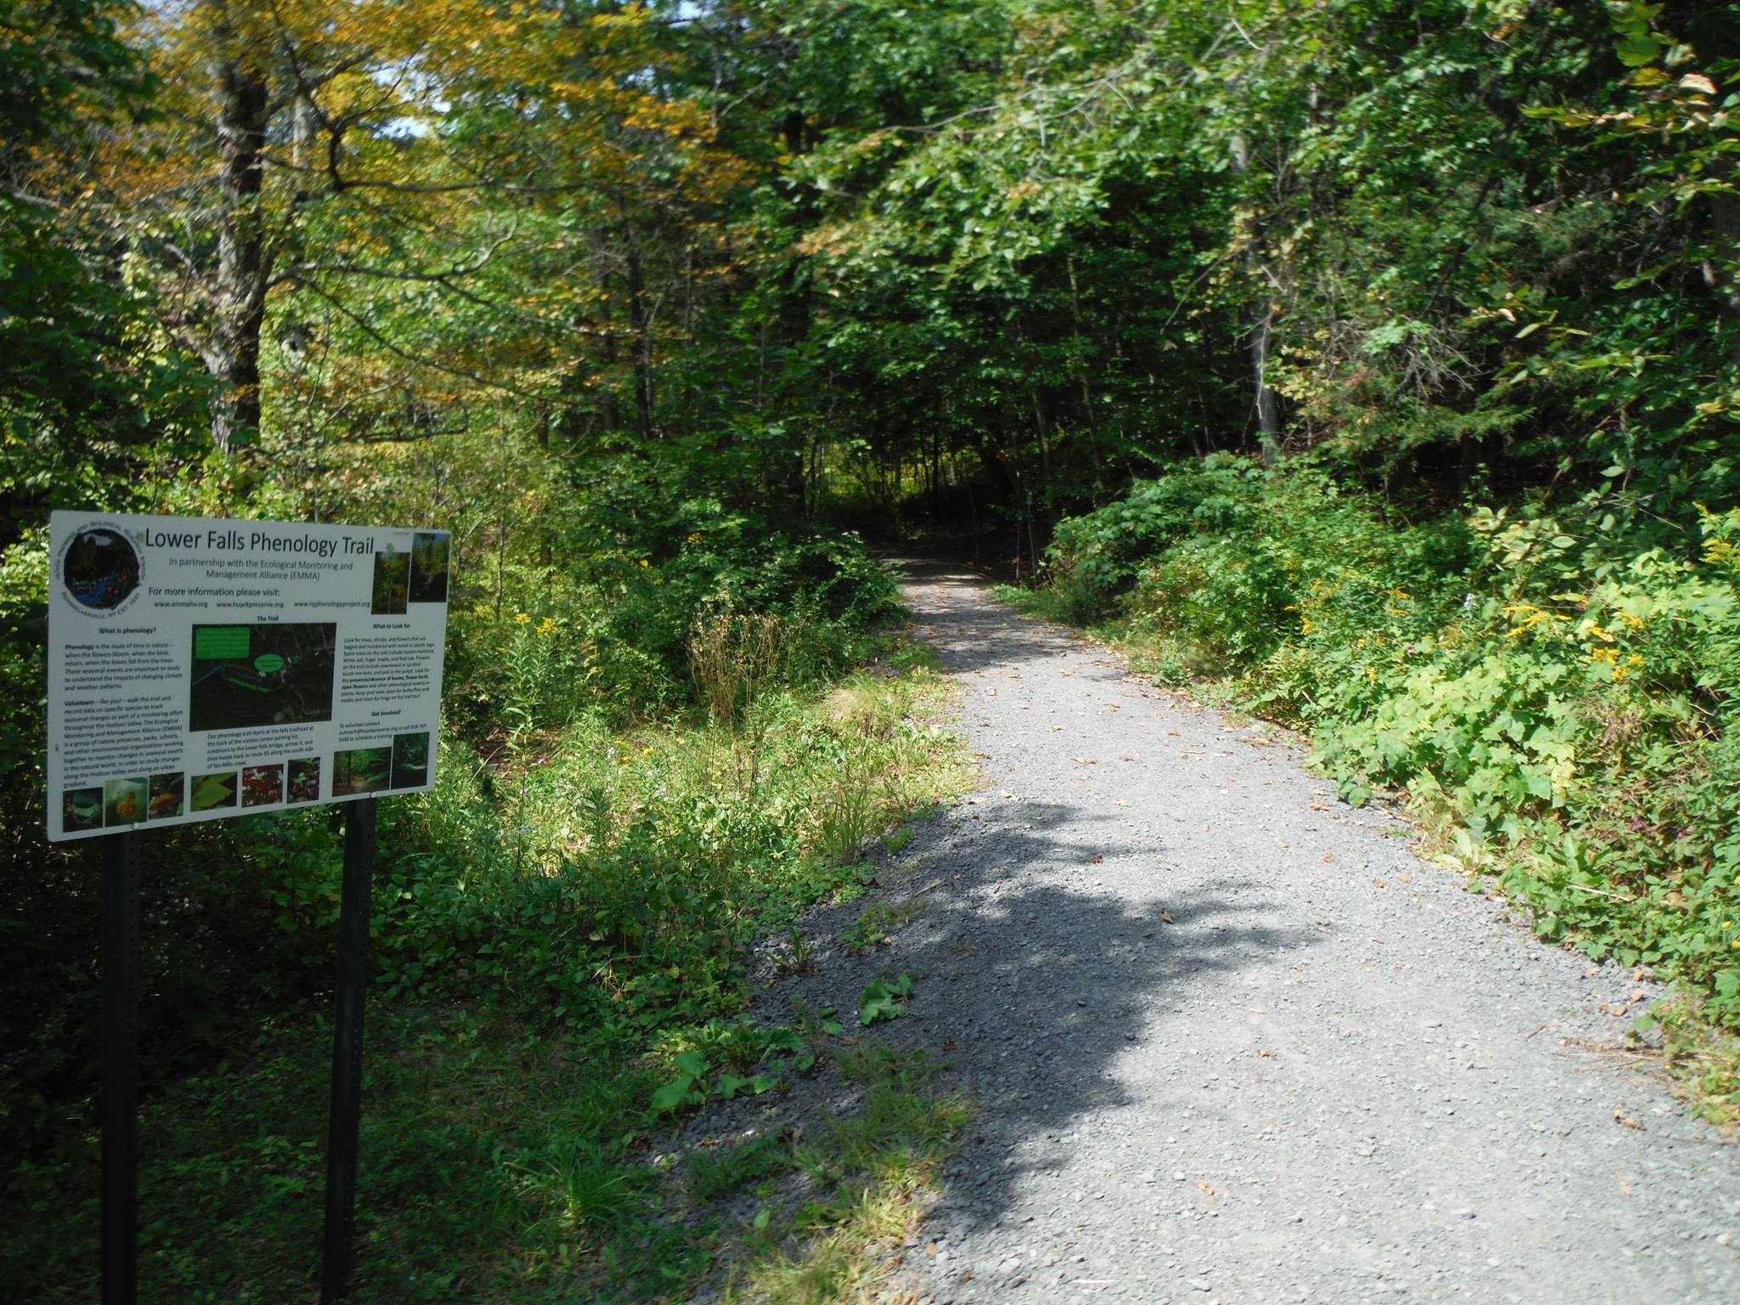
Phenology Volunteer Orientation Huyck Preserve

Slide 2
Registering for Nature’s Notebook
Data is entered in real-time using the Nature’s Notebook app on your smartphone.
After downloading the Nature’s Notebook app, you must create an account through the USA National Phenology Network website: www.usanpn.org.
Once on the homepage of
the website, click on
Nature’s Notebook Home
at the top of the page.

Slide 3
Registering for Nature’s Notebook
Once on the Nature’s Notebook Homepage, click on the Observe tab near the top of the page.
Underneath the Observe tab, click on Become an Observer.

Slide 4
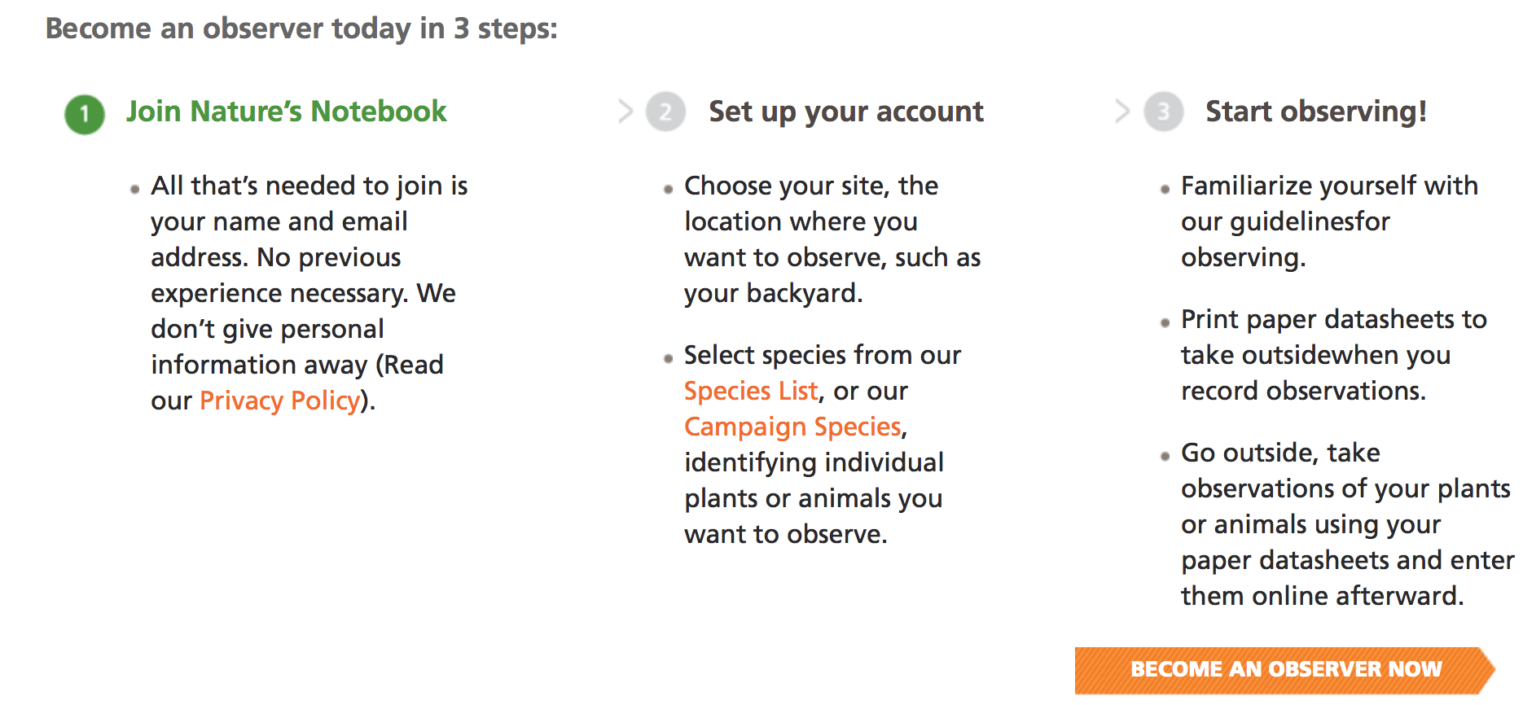
Registering for Nature’s Notebook
After clicking on Become an Observer follow the three steps listed at the bottom of the page.

Slide 5
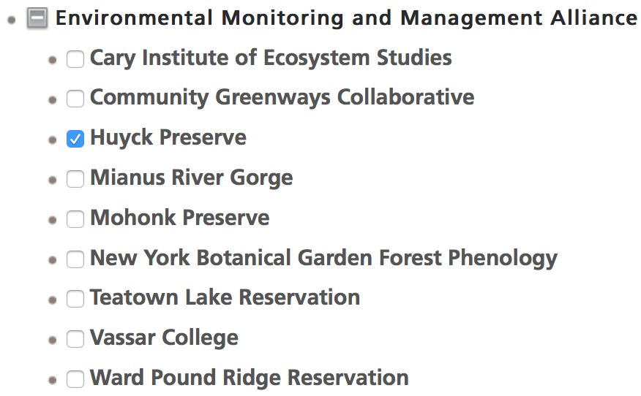
Registering for Nature’s Notebook
Once you reach the registration form, under Partner Groups scroll down to Environmental Monitoring and Management Alliance and select the Huyck Preserve.

Slide 6
Step-by-Step Registration
When you have registered, go into your observation deck and find “my account details.”
Click on the Edit tab.
Under Partner Groups, find Environmental Monitoring and Management Alliance and select the Huyck Preserve. Be sure that only the box next to the Huyck Preserve is checked and not NYPP. Make sure you click “save” at the bottom.
Click on My Observation Deck now and under Sites, you should see a drop down menu that includes the Huyck Preserve. Click on this and you should see the species list of plants and animals in a drop down menu to the right.

Slide 7
Identifying the Trees of the Huyck Preserve’s Phenology Trail

Slide 8
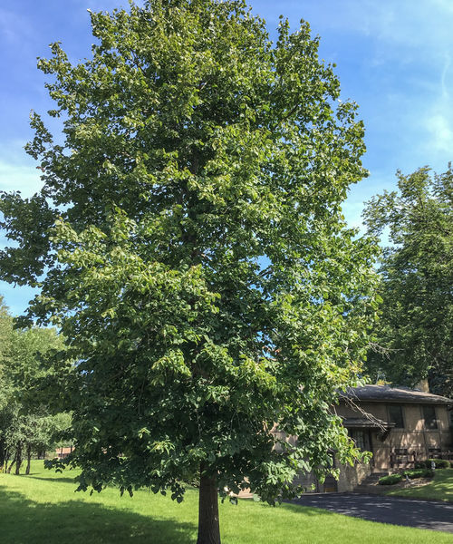
American Basswood (Tilia americana) Wide-spreading, round-topped tree with dense foliage

Slide 9
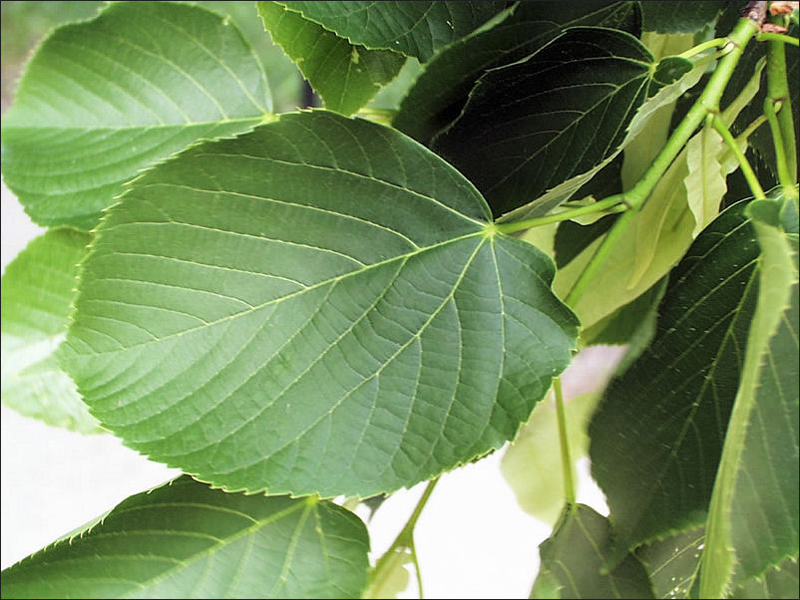
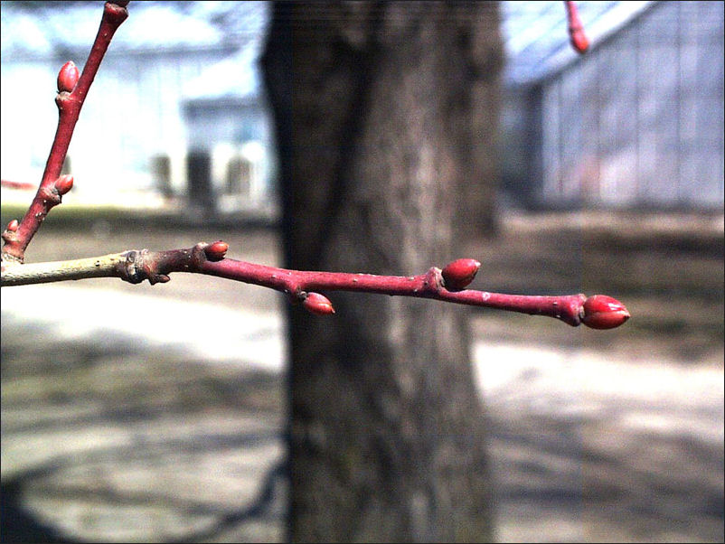
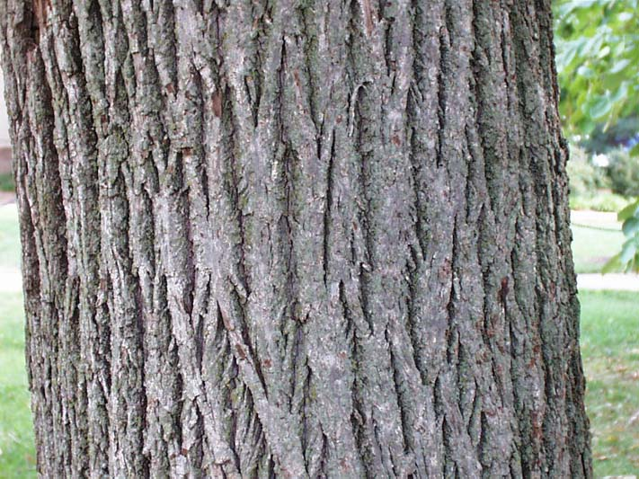
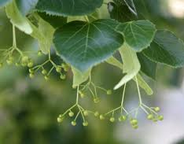
American Basswood Identification
Leaves:
Alternately arranged
Heart-shaped
Unequal bases
Coarsely toothed
Twigs:
Light brown to gray in color
Prominent dark red buds
Bark
Young Trees: light or silver gray
Older Trees: Dark gray to almost black. Furrowed
Fruit – a hanging cluster of nutlets attached to a leafy bract.

Slide 10
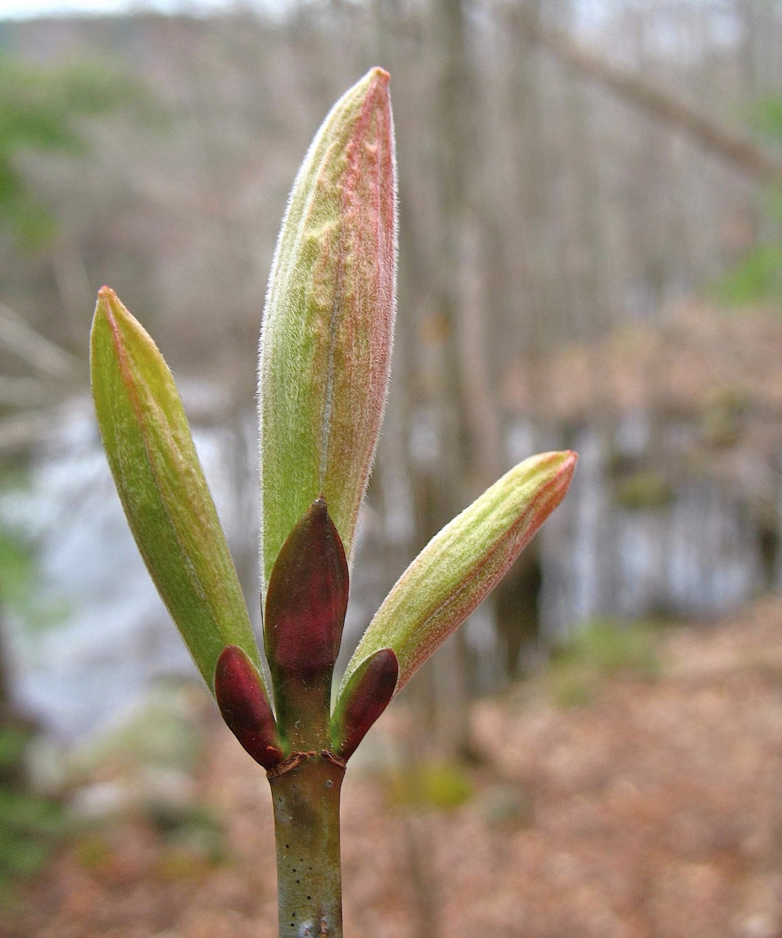
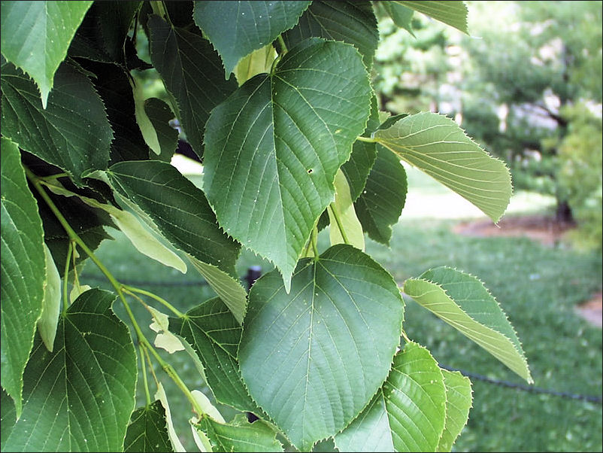
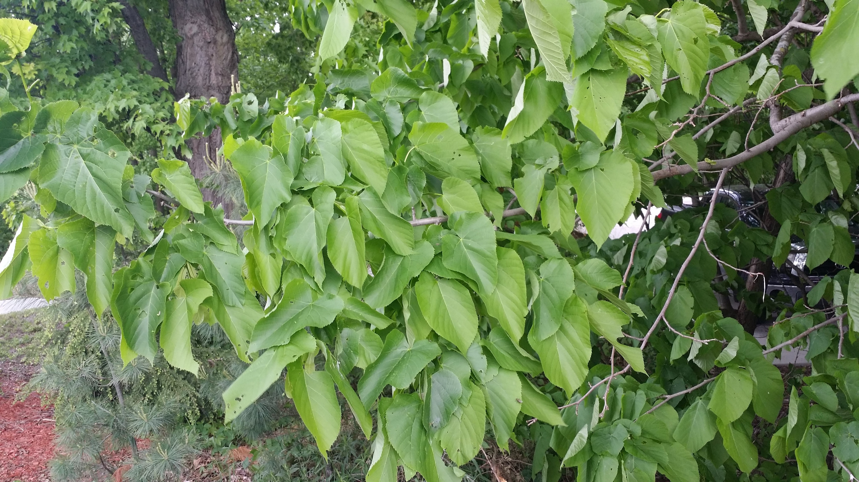
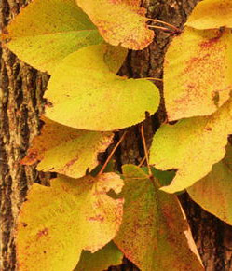
American Basswood Phenophases
Breaking Leaf Bud
Leaves
Increasing Leaf Size
Colored Leaves
One or more breaking leaf buds visible. A leaf bud is “breaking” once a green leaf tip is visible at the end of the bud, but before the first leaf from the bud has unfolded to expose the leaf stalk or leaf base.
One or more live, unfolded leaves visible. A leaf is “unfolded” once its entire length has emerged from a breaking bud so that the leaf stalk is visible at the attachment to the stem. Do not include fully dried or dead leaves.
Majority of leaves have not reached full size and are continuing to grow larger. Do not include new leaves that continue to emerge at ends of elongating stems through the growing season.
One or more leaves show their typical late-season color, or yellow or brown due to drought or other stressors. Do not include small spots of color from leaf damage or dieback on branches. Do not include fully dried or dead leaves.

Slide 11
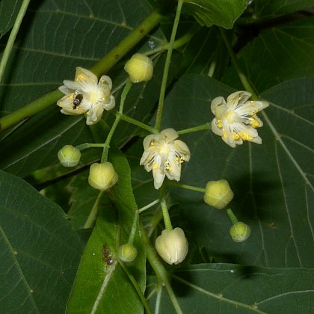
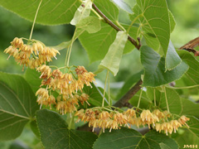
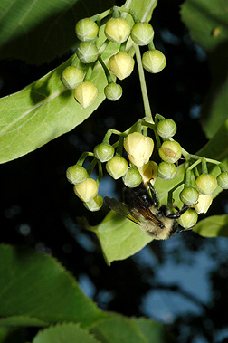
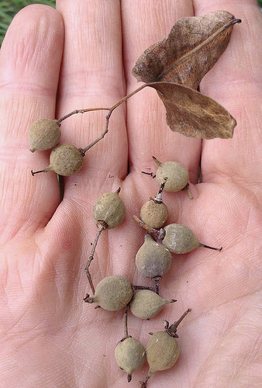
American Basswood Phenophases
Flowers or Flower Buds
Open Flowers
Fruits
Ripe Fruits
One or more open or unopened flowers/flower buds visible. Include flower buds that are swelling or expanding. Do not include tightly closed and dormant flowers. Do not include wilted or dried flowers.
One or more open flowers visible. Flowers are considered “open” when the reproductive parts are visible between or within unfolded or open flower parts. Do not include wilted or dried flowers.
One or more fruits visible. Fruits are small and nut-like that change from green to brown or reddish-brown.
One or more ripe fruits visible. Fruit is considered ripe when it has turned brown or reddish-brown.

Slide 12
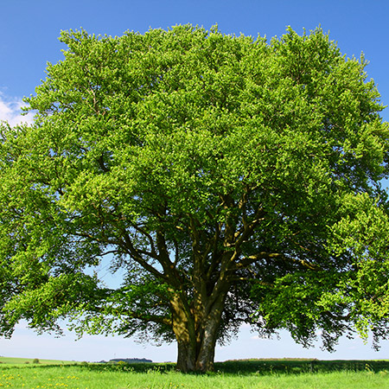
American Beech (Fagus grandifolia) Large tree with distinctive silver bark

Slide 13
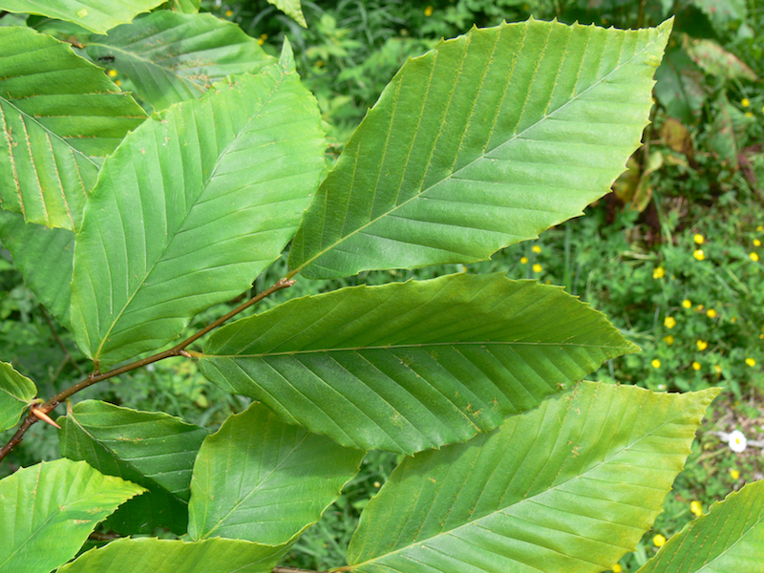
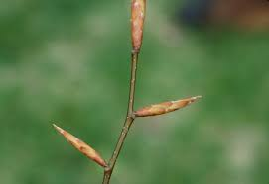
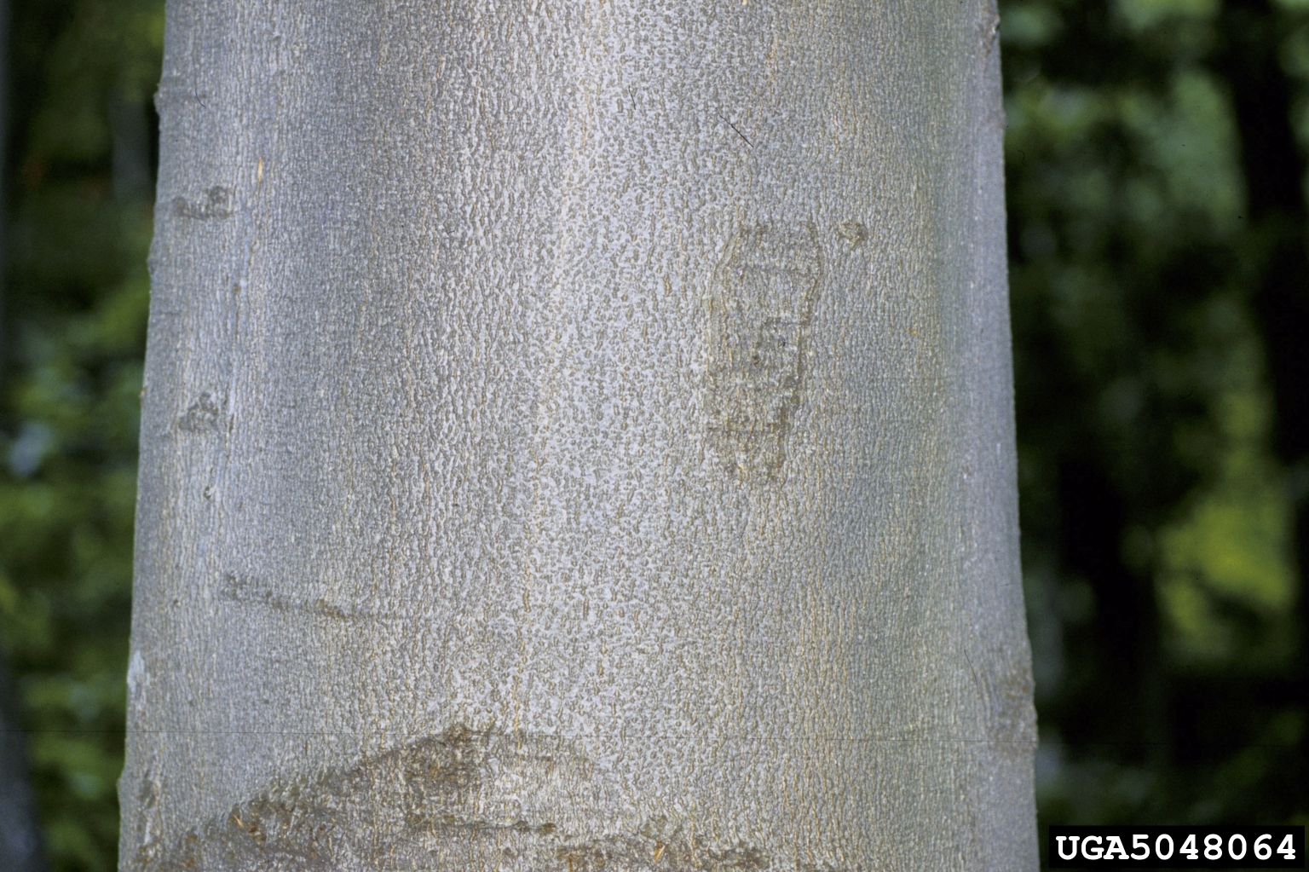
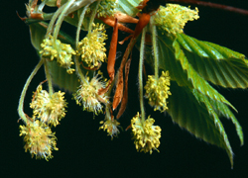
American Beech Identification
Leaves
Alternate
Waxy & smooth, dark green
Elliptical shape
Straight parallel veins on short stalks that end in a distinct tooth
Twig
Light brown & slender, zigzag
Buds are light brown, cigar shaped, look like long thorns
Bark
Smooth, thin, & gray (in healthy individuals) (cankered in trees with beech bark disease)
Flowers
Male – globose heads hang from 1 in. stalk
Female – Flowers on shorter spikes
Nuts
Irregularly triangular & shiny brown

Slide 14
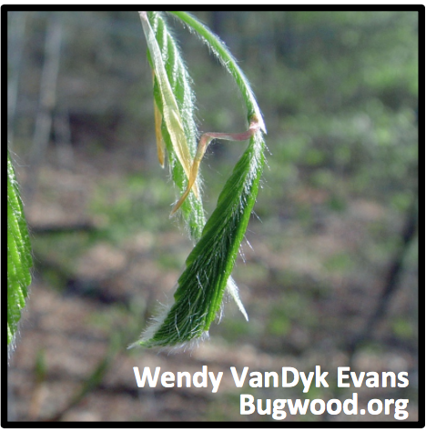
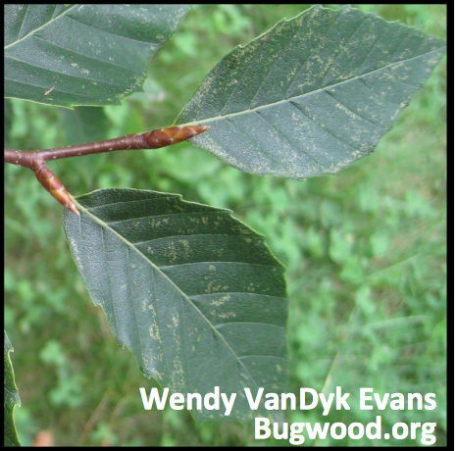
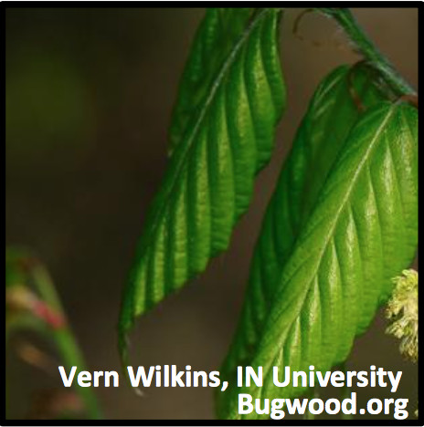
American Beech Phenophases
Breaking Leaf Bud
Leaves
Increasing Leaf Size
Colored Leaves
A leaf bud is breaking once a green leaf tip is visible at the end of the bud, but before the first leaf has unfolded to expose the leaf stalk or leaf base.
One or more live unfolded leaves are visible. A leaf is unfolded once its entire length has emerged from a breaking bud. The leaf stalk is visible at its point of attachment to the stem.
A majority of leaves have not reached their full size and are still growing larger. Do not include new leave that continue to emerge at the ends of elongating stems through the season.
One or more leaves (including recently fallen) have turned to their late-season colors. Do not include fully dried or dead leaves that remain on the plant

Slide 15
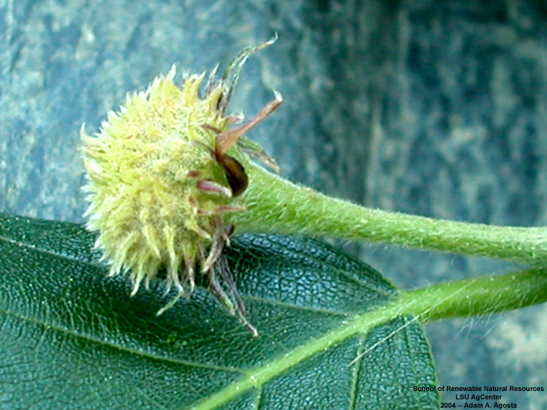
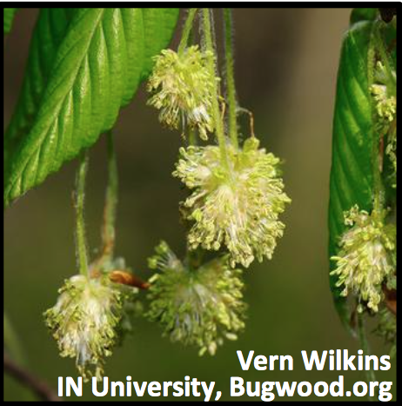
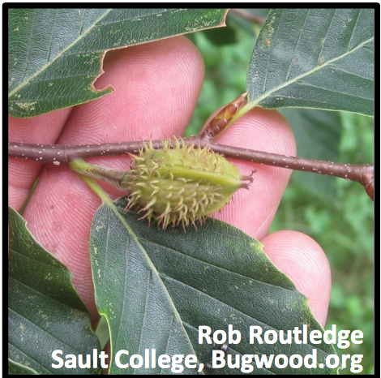
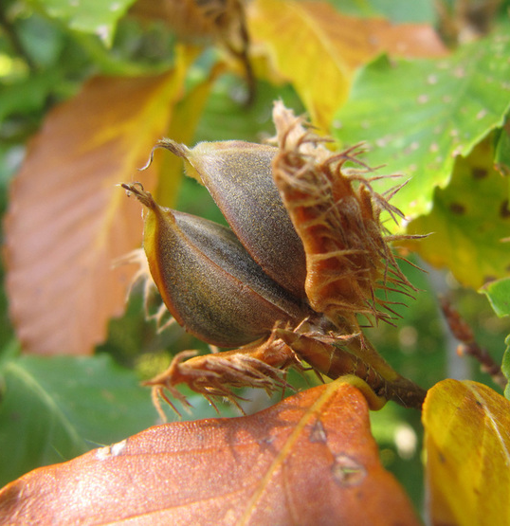
American Beech Phenophases
Flowers or Flower Buds
Open Flowers
Fruits
Ripe Fruits
One or more fresh open or unopened catkins (males) or small flowers (females) are visible. Include developing flower buds but not wilted or dried flowers or catkins.
One or more fresh flowers are visible. Male flowers are open when catkins lengthen and stamens protrude. Females are open when pistils are visible.
One or more fruits are visible on the plant. Fruit is a nut covered by a spiny husk (burr) that changes from green to brown to reddish-brown. Do not include empty husks.
One or more ripe fruits are visible. Husk has turned brown or reddish-brown and split open to expose the two nuts. Do not include empty husks.

Slide 16
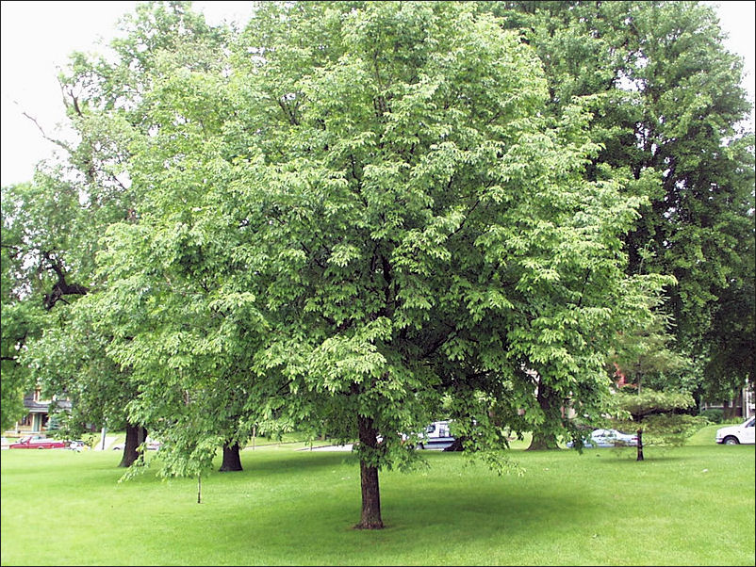
American Hophornbeam (Ostrya virginiana) Small, slow-growing, shapely tree

Slide 17
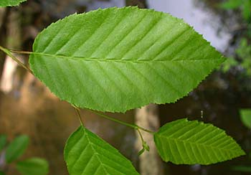
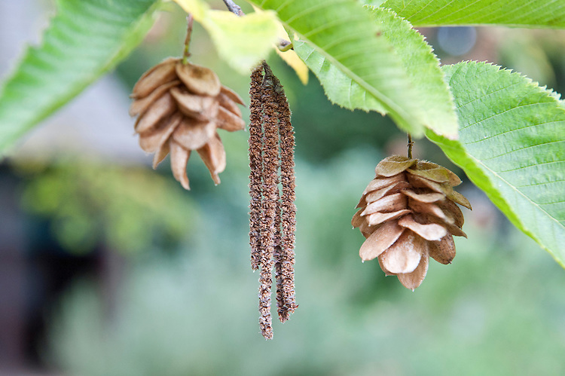
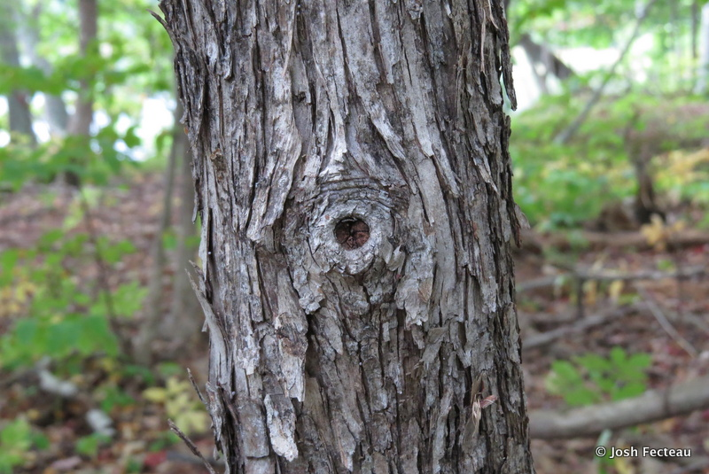
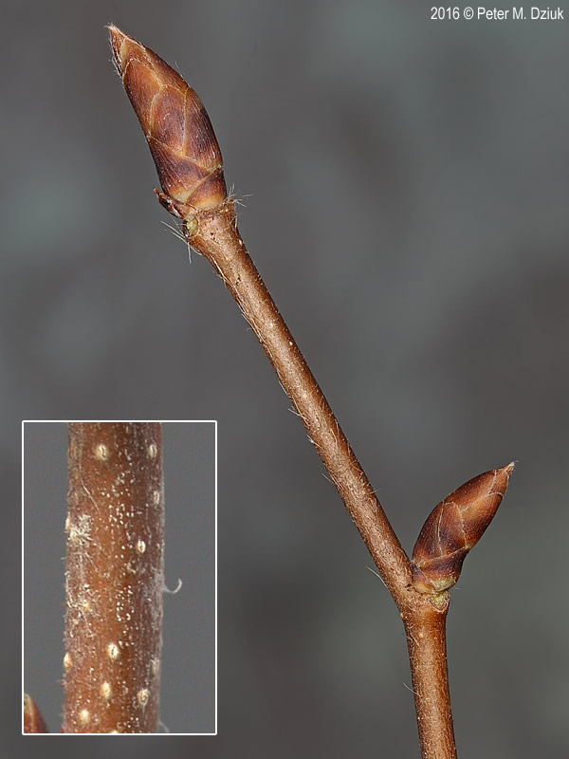
American Hophornbeam Identification
Leaves
Alternate, elliptical shape & doubly serrated
Prominent veins, drawn-out tip
Twig
Smooth, reddish brown
Egg shaped buds at ends, with green & red-brown scales
Bark
Gray-brown
Young – very flaky, loosely covers spreading branches & upper trunks
Mature – thin vertical strips, slighting shredding at the ends
Flower
Catkins - green in summer, brown in winter
Fruit
often in clusters of 3, hop-like fruit (lime green in early summer, beige-yellow in midsummer, brown in late summer)

Slide 18
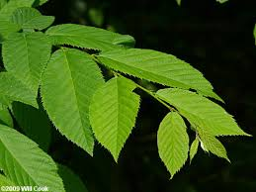
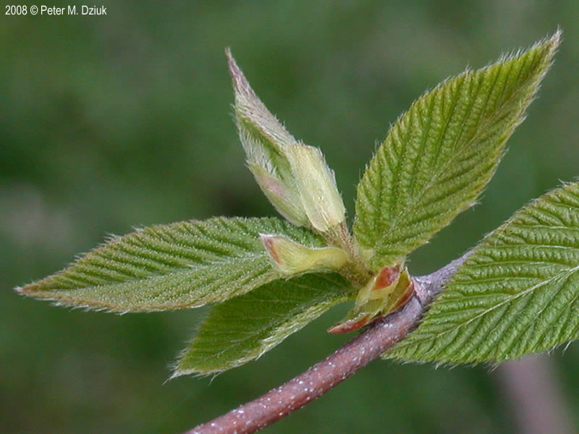
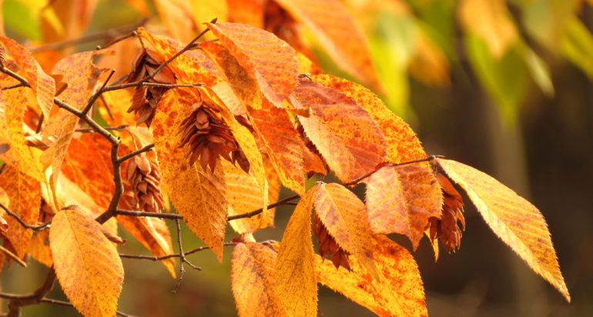
American Hophornbeam Phenophases
Breaking Leaf Bud
Leaves
Increasing Leaf Size
Colored Leaves
One or more breaking leaf buds visible. A leaf bud is considered ”breaking” once a green leaf tip is visible at the end of the bud but before the first leaf from the bud has unfolded to expose the leaf stalk.
One or more unfolded leaves visible. A leaf is considered ”unfolded” once its entire length has emerged from a break bud so that the leaf stalk is visible at its attachment to the stem. Do not include fully dried or dead leaves.
Most leaves are not full size and are still growing larger. Do not include new leaves that continue to emerge at the ends of elongating stems through the growing season.
One or more leaves (including recently fallen) have turned to late-season color or changed due to drought or pests. Do not included fully dried or dead leaves.

Slide 19
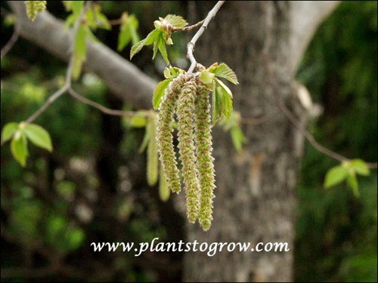
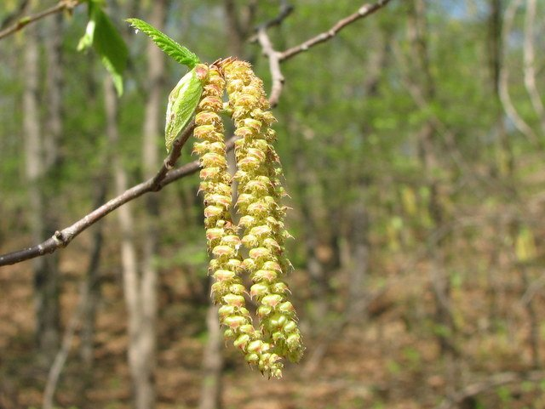
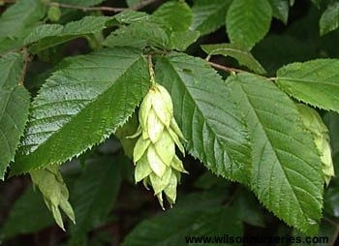
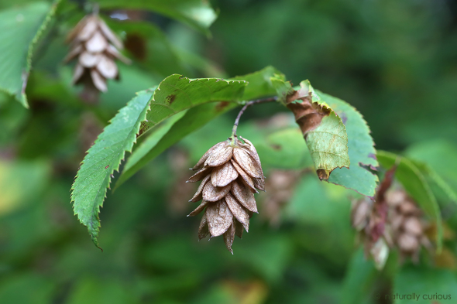
American Hophornbeam Phenophases
Flowers or Flower Buds
Open Flowers
Fruits
Ripe Fruits
One or more open or
unopened flowers/flower buds visible. Include flower buds that are swelling or expanding. Do not include tightly closed and dormant flowers. Do not include wilted or dried flowers.
One or more open flowers visible. Flowers are considered “open” when the reproductive parts are visible between or within unfolded or open flower parts. Do not include wilted or dried flowers.
One or more fruits are visible. Fruits are hop-like and normally come in clusters of 3. Unripe fruits are lime green to beige-yellow in color.
One or more ripe fruits are visible. Fruits are ripe after they have turned tan or brownish and readily drop from the tree when touched. Do not include immature fallen fruits.

Slide 20
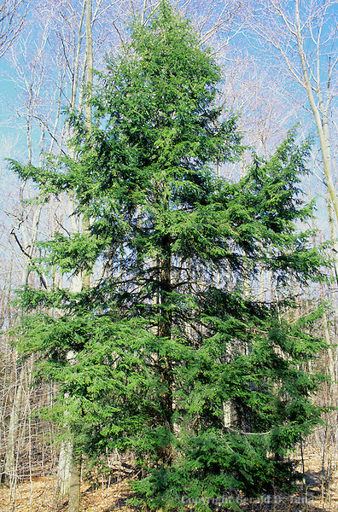
Eastern Hemlock (Tsuga canadensis) Conifer with heavily foliaged and upsweeping branches

Slide 21
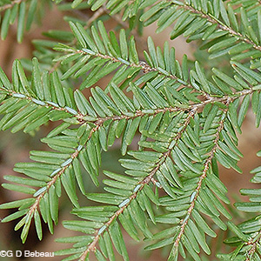
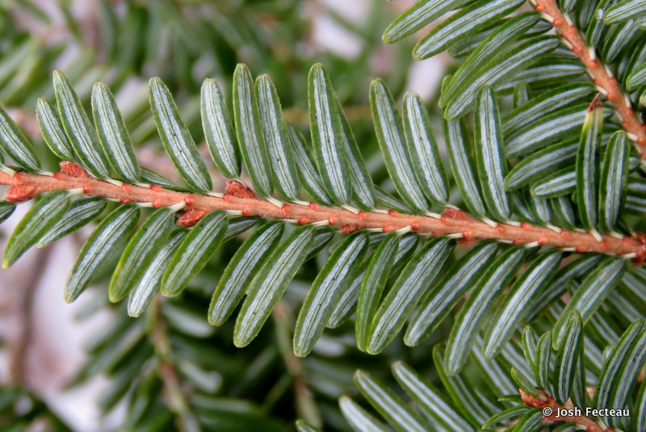
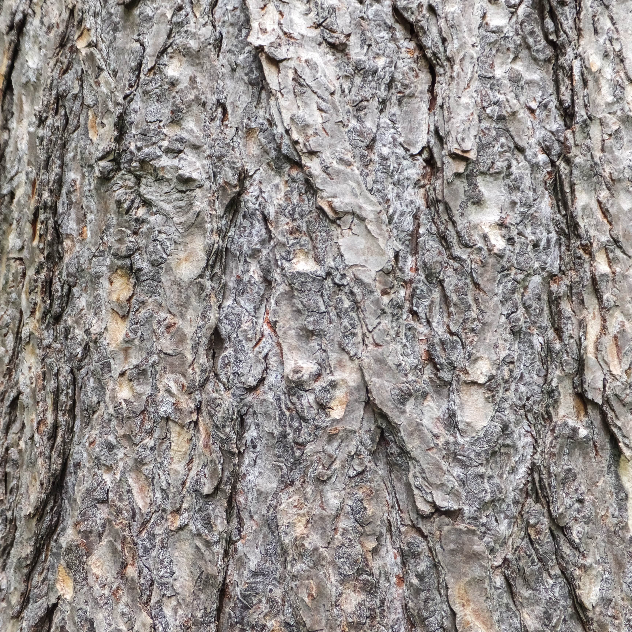
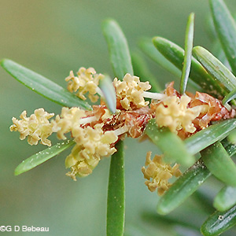
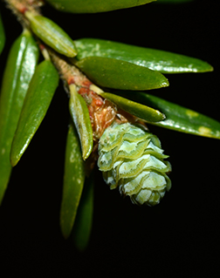
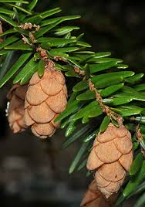
Eastern Hemlock Identification
Leaves
Evergreen, flat, single needles
Taper to a dull point
Shiny, dark green above, 2 lines of white stomata below
Twig
Slender, gray-brown in color
Buds are very small
Bark
Young – gray-brown, smooth then turning scaly
Mature – red-brown with wide ridges and furrows
Obvious purple streaks when cut or broken
Flower
Males – small, round, & yellow
Females – light green at the branch tips
Fruit
Small, egg-shaped light-brown cone
Rounded scales

Slide 22
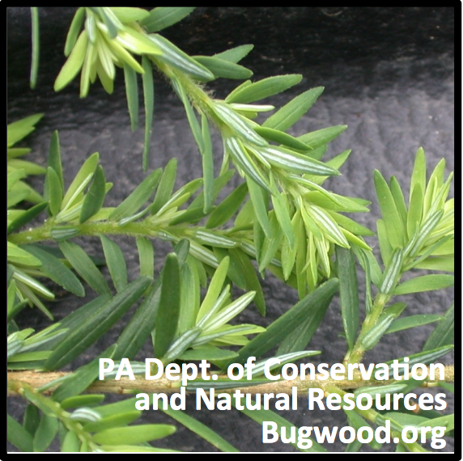
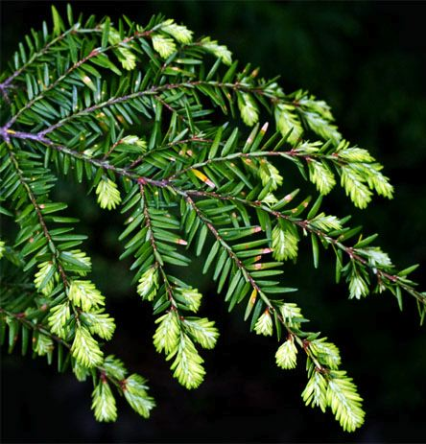
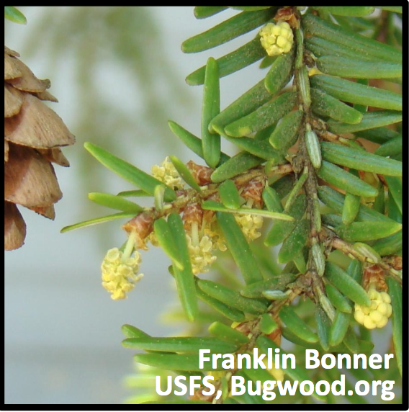
Eastern Hemlock Phenophases
Young Needles
Pollen Cones
Open Pollen Cones
Breaking Needle Buds
One or more breaking needle buds visible. A needle bud is ”breaking” once a green needle tip is visible at the end of the bud but before the first needle from the bud has unfolded and spread away at an angle.
One or more young open needles visible. A “young” unfolded needle has spread away from the developing stem so that its point of attachment to the stem is visible, but before it has reached the size, color, or texture of mature needles.
One or more fresh, male pollen cones are seen. Cones have overlapping scales that are initially tightly closed. Include unopened and open cones but not wilted or dried cones that have released their pollen.
One or more fresh, male pollen cones are visible. Cones are “open” when scales have spread apart to release pollen. Do not include wilted or dried cones that have released all of their pollen.

Slide 23
Eastern Hemlock Phenophases
Pollen Release
Unripe Seed Cones
Ripe Seed Cones
Recent Fruit or Seed Drop
One or more male cones release visible pollen grains when gently shaken or blown into your palm or onto a dark surface.
One or more unripe female seed cones are visible on the plant. An unripe seed cone is green or brown with closed scales.
One or more ripe female seed cones visible. Seed cones are ripe when they have turned brown and the scales have begun to spread apart to expose the seeds inside. Do not include empty cones.
One or more seed cones or seeds have dropped or been removed since the last visit. Do not include empty seed cones that had long ago dropped all their seeds but remain on the plant.

Slide 24
Red Maple (Acer rubrum) Large tree with distinctive red in all seasons: buds in winter, flowers in spring, leaf stalks in summer, and leaves in fall

Slide 25
Red Maple Identification
Leaves
Opposite, 3-5 lobed
Serrated lobe margins, shallow sinuses
Green above & whitened & sometimes hairy beneath
Twig
Reddish and lustrous with small lenticels
Buds are blunt, green or reddish with loose scales
V-shaped leaf scars, 3 bundle scars
Bark
Young trees – smooth and light gray
Mature trees – darker, broken up into long, fine scaly plates
Flower
Small, occur in hanging clusters
Usually bright red, sometimes, yellow
Appear in early spring usually before leaves
Fruit
Clusters of long samaras with slightly divergent wings
Long, slender stems
Red, pink or yellow color

Slide 26
Red Maple Phenophases
Breaking Leaf Buds
Leaves
Increasing Leaf Size
Colored Leaves
One or more breaking leaf buds are visible. A ”breaking” leaf bud shows green leaf tips at the end of the bud, but the leaf stalks are not yet visible. Leaf tips may appear reddish.
One or more live unfolded leaves visible. An “unfolded” leaf has entirely emerged from the breaking bud. The leaf stalk is visible at the point of attachment to the stem. Fully dried & dead leaves not included.
Most leaves are not full size and are still growing larger. Do not include new leaves that continue to emerge at the ends of elongating stems through the growing season.
One or more leaves (including recently fallen) have turned to late-season color or changed due to drought or pests. Do not included fully dried or dead leaves.

Slide 27
Red Maple Phenophases
Flowers or Flower Buds
Open Flowers
Fruits
Ripe Fruits
One or more fresh open or unopened flowers or flower buds are visible including developing flower buds. Do not include wilted or dried flowers. The circled flower is open.
One or more open fresh flowers are visible. Flowers are “open” when reproductive parts are visible within unfolded flower parts. Do not include wilted or dried flowers.
One or more fruits are visible on the plant. Fruits are two seeds joined in a “V” shape with each seed having a wing. Unripe fruits are green or reddish.
One or more ripe fruits are visible. Fruits are ripe after they have turned tan or brownish and readily drop from the tree when touched. Do not include immature fallen fruits.

Slide 28
Red Oak (Quercus rubra) Tallest and fastest growing of the oaks

Slide 29
Red Oak Identification
Leaves
Alternate, 7-11 bristle-tipped lobes
Sinuses of the lobes are u-shaped
Dull-green to blue-green in color above & paler below
Twig
Stout, red-brown, no hair
Multiple terminal buds covered with red-brown scales
Bark
Wide, flat-topped ridges & shallow furrows that resemble ski tracts
Flower
Males – yellow-green slender catkins
Females – auxiliary spikes, appear with leaves in the spring
Fruit
Nearly round acorns
Flat and thick cap, resembles a beret

Slide 30
Red Oak Phenophases
Breaking Leaf Buds
New Leaves
Increasing Leaf Size
Colored Leaves
One or more breaking leaf buds visible. A leaf bud is “breaking” once a green or pinkish leaf tip is visible at the end of the bud but before the first leaf from the bud has unfolded to expose the leaf stalk.
One or more live unfolded leaves visible. A leaf is “unfolded” once its entire length has emerged from the breaking bud so that the leaf stalk is visible where it attaches to the stem. Fully dried & dead leaves not included
Majority of leaves have not reached full size and are growing larger. Do not include new leaves that continue to emerge at elongating stems during the growing season.
One or more leaves (including recently fallen) have turned to their late-season colors or changed due to drought or pests. Do not include dried or dead leaves that remain on the plant.

Slide 31
Red Oak Phenophases
Flowers or Flower Buds
Open Flowers
Fruits
Ripe Fruits
One or more fresh open or unopened flowers or flower buds are visible. Catkins contain the male flowers while female flowers grow on short stems. Include developing flower buds but not wilted or dried flowers.
One or more fresh flowers are visible. Male flowers are open when the catkin has unfolded and hanging loosely. Female flowers are open with pistils are visible. Do not include wilted or dried flowers.
One or more fruits are visible on the plant. The fruit is a nut that is partially covered with a “cap” and changes from green to green-brown to brown, red-brown, or dark brown.
One or more ripe fruits are visible. A fruit is considered ripe when it has turned brown, red-brown, or dark brown.

Slide 32
Striped Maple (Acer pensylvanicum) Large shrub or small tree characterized by striped trunk and large leaves

Slide 33
Striped Maple Identification
Leaves
Opposite, lobbed, large, thin, somewhat papery
3 triangular forward-pointing lobes with a large central lobe
Base is rounded or slightly heart-shaped
Twigs
Green & hairless
Become striped with whitish lines
Bark
Green with thin stripes
Becomes gray as the tree ages
Flowers
Bright yellow & bell-shaped
Long clusters
Fruits
Widely spaced wings (samaras) that are reddish in early development & change to tan

Slide 34
Striped Maple Phenophases
Breaking Leaf Bud
Leaves
Increasing Leaf Size
Colored Leaves
One or more breaking leaf buds visible. A leaf bud is considered ”breaking” once a green leaf tip is visible at the end of the bud but before the first leaf from the bud has unfolded to expose the leaf stalk.
One or more unfolded leaves visible. A leaf is considered ”unfolded” once its entire length has emerged from a break bud so that the leaf stalk is visible at its attachment to the stem. Do not include fully dried or dead leaves.
Majority of leaves have not reached their full size and are growing larger. Do not include new leaves that continue to emerge at the ends of elongating stems through the growing season.
One or more leaves show their typical late-season color, or yellow or brown due to drought or other stressors. Do not include small spots of color from leaf damage or dieback on branches. Do not include fully dried or dead leaves.

Slide 35
Striped Maple Phenophases
Flowers or Flower Buds
Open Flowers
Fruits
Ripe Fruits
One or more open or
unopened flowers/flower buds visible. Include flower buds that are swelling or expanding. Do not include tightly closed and dormant flowers. Do not include wilted or dried flowers.
One or more open flowers visible. Flowers are considered “open” when the reproductive parts are visible between or within unfolded or open flower parts. Do not include wilted or dried flowers.
One or more fruits are visible. Fruits are two joined seeds in a “V” shape. Each seed has a wing that changes from green to tan or brownish and drops from the plant.
One or more ripe fruits visible. Fruits are considered ripe when it has turned tan or brownish and readily drops from the plant when touched.

Slide 36
Sugar Maple (Acer saccharum) Tall, long-lived tree with dense, rounded crown

Slide 37
Sugar Maple Identification
Leaves
Opposite & 5-lobed
Deeply cut, rounded divisions between lobes
Dark green above & paler underneath
Twigs
Opposite on the stem
Smooth & gray to brown in color
Bark
Light to dark gray
Narrowly ridged with long deep furrows
Sometimes scaly
Flowers
Greenish & inconspicuous
Fruits
2-winged samara
Mature in the fall

Slide 38
Sugar Maple Phenophases
Breaking Leaf Bud
Leaves
Increasing Leaf Size
Colored Leaves
One or more breaking leaf buds are visible. A leaf bud is “breaking” once a green leaf tip is visible at the end of the bud, but before the first leaf from the bud has unfolded to expose the leaf stalk.
One or more live unfolded leaves are visible. A leaf is unfolded once its full length has emerged from the bud so the leaf stalk is visible where it attaches to the stem. Do not include fully dried or dead leaves.
Majority of leaves have not reached their full size and are still growing larger. Do not include new leaves that continue to emerge at the ends of elongating stems through the growing season.
One or more leaves (including recently fallen) have turned to their late-season colors. Do no include fully dried or dead leaves that remain on the plant.

Slide 39
Sugar Maple Phenophases
Flower or Flower Buds
Open Flowers
Fruits
Ripe Fruits
One or more fresh open or unopened flowers or flower buds are visible on the plant. Include flower buds that are still developing. Do not include wilted or dried flowers.
One or more open or fresh flowers are visible. Flowers are ”open” when the reproductive parts are visible between open flower parts. Do not include wilted or dried flowers.
One or more fruits are visible. Fruit are two joined seeds in a “V” shape with each seed having a wing that is green when unripe and yellowish-green or brownish when ripe.
One or more ripe fruits are visible. Fruit is considered ripe when it has turned yellowish-green or brownish and readily drops when touched.

Slide 40
White Ash (Fraxinus americana) Tall tree with compound leaves and distinctive furrowed bark (cantoulope)

Slide 41
White Ash Identification
Leaves
Opposite, compound, 5-9 leaflets
Leaflets without teeth or slightly toothed
Upper surface glossy dark green, lower surface light green without hair
Twigs
Gray or brown, large brown terminal bud
Leaf scars have half-round shape, conspicuous v-shaped notch in the top
Bark
Ash gray to brown
Interlacing corky ridges that form obvious diamonds
Flowers
Light green to purplish, lacking petals
Females in loose panicles & males tight clusters
Fruit
One winged, dry, flattened samara
Rounded seed cavity

Slide 42
White Ash Phenophases
Leaves
Colored Leaves
Breaking Leaf Bud
Increasing Leaf size
One or more breaking leaf buds are visible. A leaf bud is considered “breaking” once a green leaf tip is visible at the end of the bud but before the first leaf from the bud has unfolded to expose the leaf stalk.
One or more live unfolded leaves visible. A leaf is “unfolded” once its entire length has emerged from a breaking bud so that the leaf stalk is visible at the attachment to the stem. Do not include fully dried or dead leaves.
A majority of leaves have not reached their full size and are still growing larger. Do not include new leaves that continue to emerge at the ends of elongating stems throughout the growing season.
One or more leaves show their typical late-season color, or yellow or brown due to drought or other stressors. Do not include small spots of color from leaf damage or dieback on branches. Do not include fully dried or dead leaves.

Slide 43
White Ash Phenophases
Flowers or Flower Buds
Open Flowers
Fruits
Ripe Fruits
One or more fresh open or unopened flowers & buds visible. Male flower heads grow fuller and fluffier while females grow feathering and hang loosely. Both males and females emerge from buds on the twig below the breaking leaf bud or new leaves.
One or more fresh open flowers visible. Flowers are “open” when the reproductive parts are visible. Flowers open when the flower heads lengthen and reproductive parts protrude making the males appear fuller and fluffier and the females appear feathery.
One or more fruits visible. Fruits are winged seeds that change from green or reddish-green to tan or brown.
One or more ripe fruits are visible. Fruits are considered ripe when they have turned tan or brown.

Slide 44
Identifying the Shrubs of the Huyck Preserve’s Phenology Trail

Slide 45
American Witchhazel (Hamamelis virginiana)

Slide 46
American Witchhazel Identification
Leaves
Alternate & egg shaped
Large wavy teeth on margins
Unequal offset leave base
Upper surface is dark green, lower surface is a paler green
Twig
Slender, light brown, lack scales
Bark
Smooth, gray to gray-brown
Flowers
Bright yellow, 4 slender petals
Fruit
Woody, brown capsule
Contains 2 shiny black seeds

Slide 47
American Witchhazel Phenophases
Breaking Leaf Buds
Leaves
Increasing Leaf Size
Colored Leaves
One or more breaking leaf buds are visible. A leaf bud is “breaking” once a green or brownish leaf tip is visible. Ignore very small leaves that remain undeveloped throughout the winter.
One or more live unfolded leaves are visible. A leaf is “unfolded” once its entire length has emerged and the leaf stalk is visible at the attachment to the stem. Do not include fully dried or dead leaves
Majority of leaves have not reached full size and are still growing. Do not include new leaves that continue to emerge at the ends of elongating stems throughout the growing season.
One or more leaves (including those recently fallen) have turned to their late-season colors. Do not include fully dried leaves or dead leaves that remain on the plant.

Slide 48
American Witchhazel Phenophases
Flowers or Flower Buds
Open Flowers
Fruits
Ripe Fruits
One or more fresh open or unopened flowers or flower buds are visible on the plant. Include flower buds that are still developing. Do not include wilted or dried flowers.
One or more fresh flowers are visible. Flowers are “open” when the reproductive parts are visible within the open flower parts. Do not include wilted or dried flowers.
One or more fruits are visible. Fruits are a fuzzy capsule that changes from green to brown and slits open to expose the seeds. Do not include empty capsules.
One or more ripe fruits are visible. Fruit is considered ripe when it has turned brown and split open to expose the seeds. Do not include empty capsules.

Slide 49
Mountain Maple (Acer spicatum) Small, understory tree often with multiple trunks

Slide 50
Mountain Maple Identification
Leaves
Simple & opposite
Heart-shaped at base with 3-5 lobes
2 basal lobes look like a larger tooth along serrated edges
Stalk is typically red
Upper surface – dark green & smooth
Lower Surface – paler with fine hairs
Twigs
Velvety hair
Young – brown to reddish & hairy
Mature – drab, smooth to somewhat rough
Flowers
Upright and nodding columnar panicles
Appear after leaves are fully developed
Greenish-yellow
Females – same cluster, perfect flowers, 2 small pinkish stigmas
Males – 7-8 spreading stamens
Fruit
Pair of winged seeds (samaras)
Often turn bright red
Cluster stalk becomes drooping (Sept.-Oct.)
Wings form angle near 90 degrees

Slide 51
Mountain Maple Phenophases
Breaking Leaf Buds
Leaves
Increasing Leaf Size
Colored Leaves
One or more leaf buds visible. A leaf bud is considered “breaking” once a green leaf tip is visible at the end of the bud but before the first leaf from the bud has unfolded to expose the leaf stalk.
One or more live unfolded leaves visible. A leaf considered “unfolded” once its entire length has emerged from a breaking bud so that the leaf stalk is visible at attachment to the stem. Do not include fully dried or dead leaves.
Majority of leaves have not reached full size and are still growing larger. Do not include new leaves that continue to emerge at the ends of elongating stems throughout the growing season.
One or more leaves shows their typical late-season color, or yellow or brown due to drought or other stresses. Do not include small spots of color due to damage or dieback on broken branches. Do not include fully dried or dead leaves.

Slide 52
Mountain Maple Phenophases
Open Flowers
Fruits
Ripe Fruits
Flowers or Flower Buds
One or more open or unopened flowers or flower buds are visible. Include flower buds that are expanding but do not include those that are tightly closed and dormant. Do not include wilted or dried flowers.
One or more fresh open flowers visible. Flowers are considered “open” when the reproductive parts are visible between or within folded or open flower parts. Do not include wilted or dried flowers.
One or more fruits are visible. Fruit is two joined seeds in a “V” shape that each have their own wing that changes from green to yellow or bright red, reddish-brown or brown and drops from the plant.
One or more ripe fruits are visible. Fruit are considered ripe when they have turned yellow or bright red, reddish-brown or brown and readily drops from the plant when touched.

Slide 53
Herbaceous Plant Identification

Slide 54
Jack-in-the-Pulpit (Arisaema triphyllum)

Slide 55
Jack-in-the-Pulpit Identification
Leaves
Emerge after the flowers
Each leaf has 3 leaflets
Generally oval with a pointed tip
Middle leaflet is larger than lateral 2
Leaves can tower over flowers
Flowers
Long spadix (the “Jack”) in a tubular base with a hood (the “pulpit)
Spadix is light green to reddish green
Spathe is light green to purplish green & often dotted with white or purple stripes
Fruits
Cluster berries
Unripe berries – green
Ripe berries – bright red in late summer

Slide 56
Jack-in-the-Pulpit Phenophases
Initial Growth
Leaves
Flowers or Flower Buds
New growth is visible after a period of no growth (winter or drought) with new green shoots breaking through the soil. Growth is ”initial” on each shoot until the first leaf has fully unfolded.
One or more live, unfolded leaves are visible. For seedlings, only consider true leaves and ignore the two small leaves that are found almost immediately after the seedling germinates. Do not include dried or dead leaves.
Watch for the striped pulpit which contains and hides the flowers. Do not tear open the pulpit to look for individual flowers. Include developing pulpits but do not include wilted or dried ones.

Slide 57
Jack-in-the-Pulpit Phenophases
Fruits
Ripe Fruits
Recent Fruit/Seed Drop
One or more fruits are visible. Individual fruits are berries that are clustered together and change from green to orange to bright red.
One or more ripe fruits are visible. A fruit is considered ripe when it has turned orange or bright red.
One or more mature fruits have dropped or been removed from the plant since your last visit. Do not include immature fruits that drop before ripening.

Slide 58
Jewelweed (Impatiens capensis)

Slide 59
Jewelweed Identification
Leaves
Alternate, oval shaped
Coarsely toothed margins
Whitened underside
Flowers
Pouch like-structure with a long spur
Bright orange with red-orange flecks
Fruits
Elongated capsule
Bursts at the touch when ripe

Slide 60
Jewelweed Phenophases
Initial Growth
Leaves
Flowers or Flower Buds
Open Flowers
New growth visible as new green seedlings. Growth is “initial” until the first true leaf has unfolded and includes the first two small roundish leaves.
One or more live, fully unfolded leaves visible. Include only true leaves, not the two small roundish leaves found on the stem shortly after seed germination. Do not include fully dried of dead leaves.
One or more fresh, open or unopened flowers or flower buds are visible. Include developing flower buds, but do not include wilted or dried flowers.
One or more open, fresh flowers visible. Flowers are “open” when the reproductive parts are visible. Do not include wilted or dried flowers.

Slide 61
Jewelweed Phenophases
Fruits
Ripe Fruits
Recent Fruit or Seed Drop
One or more fruits visible. Fruits are a green capsule that gradually inflates in size. Do not include empty capsules.
One or more ripe fruits visible. Fruits are ripe when they have inflated and readily explode open to release the seeds when touched. Do not include empty capsules that have already released their seeds.
One or more mature fruits or seeds have dropped or been removed since your last visit. Do not include empty fruits that dropped all of their seeds a while ago.

Slide 62
Wild (Virginia) Strawberry (Fragaria virginiana)

Slide 63
Wild (Virginia) Strawberry Identification
Leaves
Comes in 3’s, coarsely toothed
Grow on a long, hairy stalk from a central location
Flowers
White with 5 white, round petals surrounding a yellow center
Fruit
Small, red, fruit that looks like a miniature strawberry

Slide 64
Wild (Virginia) Strawberry Phenophases
Initial Growth
Leaves
Flowers or Flower Buds
New growth visible after a period of no growth (winter or drought) from above-ground buds with green tips or new shoots breaking through the soil. Growth is ”initial” on each bud or shoot until the first leaf fully opens
One or more live, fully unfolded leaves are visible. For seedlings, only consider true leaves and not the two small round or elongated leaves found almost immediately after the seed germinates.
One or more fresh open or unopened flowers or flower buds are visible. Include flower buds that are still developing but do not include wilted or dried flowers.

Slide 65
Wild (Virginia) Strawberry Phenophases
Open Flowers
Fruits
Ripe Fruits
One or more open flowers are visible. Flowers are “open” when reproductive parts are visible between open flower parts. Do not include wilted or dried flowers.
One or more fruits are visible. Fruit are tiny and seed-like and embedded on the surface of a berry-like strawberry.
One or more ripe fruits are visible. The tiny seed-like fruits are considered ripe when the strawberry has turned bright red.

Slide 67
Thank You For Your Help! Good Luck & Have Fun!

